Slide 1
Fast Refinement of the PDF

Slide 2
Lasing Modes

Slide 3
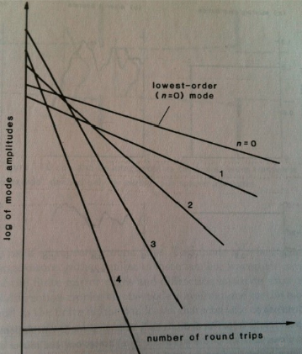
Optical Eigenmodes
What is a common laser pulse shape?
We can split a propagating pulse into the sum of solitons
Within an optical cavity, radiation is lost by all modes
Lowest loss mode has eigenvalue closest to one
For a laser that has built up over many periods in a cavity, we only care about the highest order mode (Fox and Li)

Slide 4
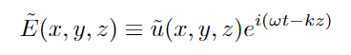
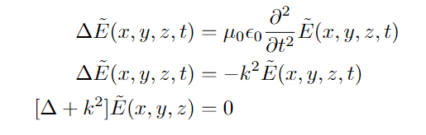
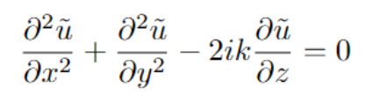
Paraxial Wave
Consider the wave equation for a wave propagating in the z-direction
Pulse Propagating in z
Apply the paraxial approximation: changes in z-direction tiny compared to gradients in other directions
Wave Equation
Paraxial Approximation

Slide 5
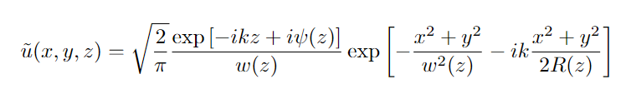
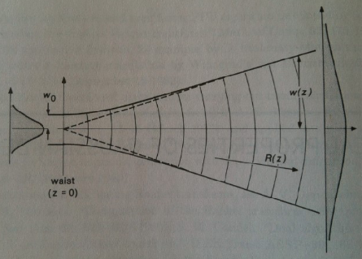
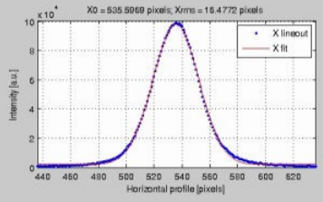
Analytical Solution
https://www.osti.gov/servlets/purl/1505100

Slide 6
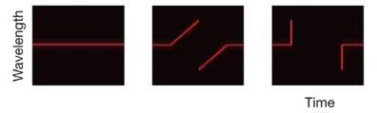
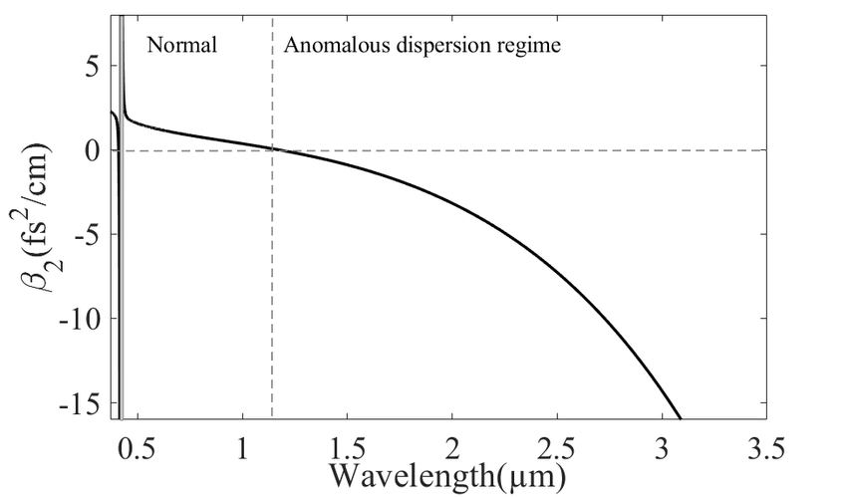
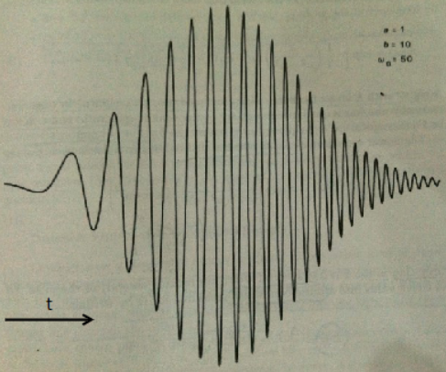
Chirping
BNL ATF uses chirping to intensify their lasers
Only Gaussian pulses have no fringe effects when chirped
https://opg.optica.org/optica/fulltext.cfm?uri=optica-2-8-675&id=323254
https://www.nature.com/articles/nature10695
https://www.mdpi.com/2079-6439/9/4/21

Slide 7
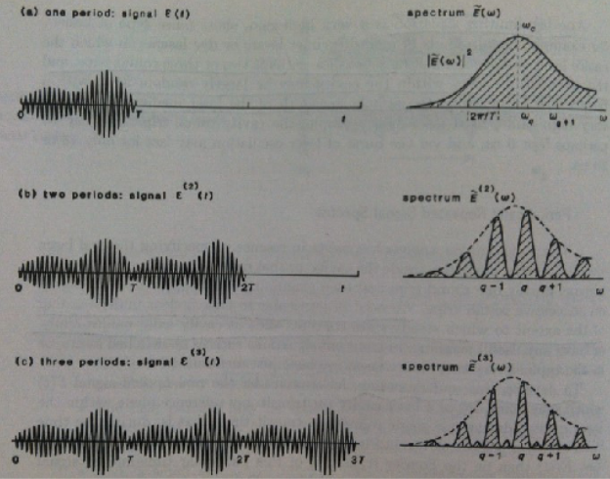
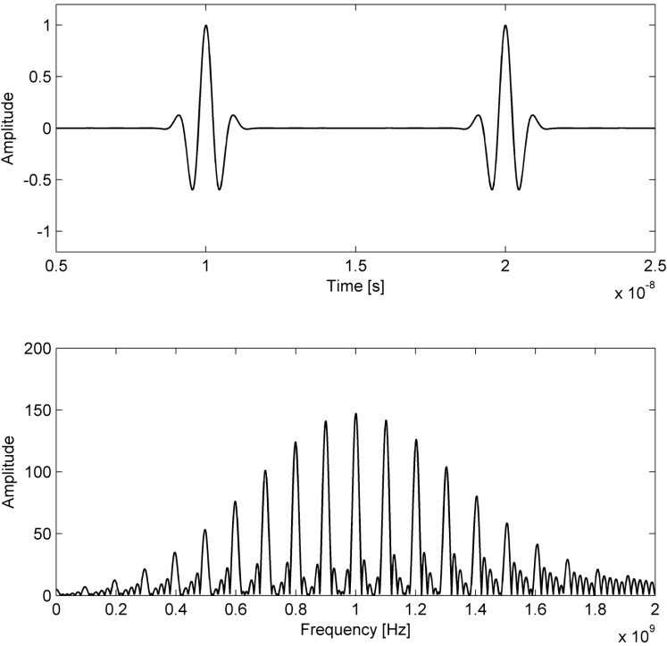
Inhomogeneous Broadening
Caused by doppler shift in gases or nonuniform strain in solids
Gaussian lineshape in frequency domain
Frequency comb is a natural result of periodic cavity signals
https://www.intechopen.com/chapters/6880

Slide 8
Convolution

Slide 9
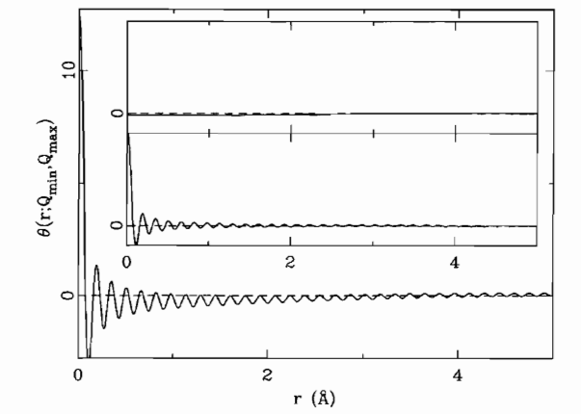
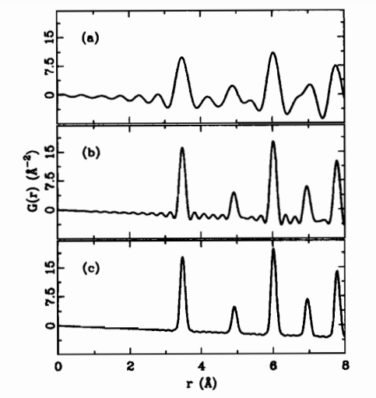
F(Q) to g(r)
Because we only consider F(Q) up to a certain Qmax, our observed g(r) becomes convoluted with a termination function
Removing the termination function requires:
Fourier transforming the signal
Dividing by the termination function at each point
Fourier transforming back
https://www.sciencedirect.com/bookseries/pergamon-materials-series/vol/16/suppl/C

Slide 10
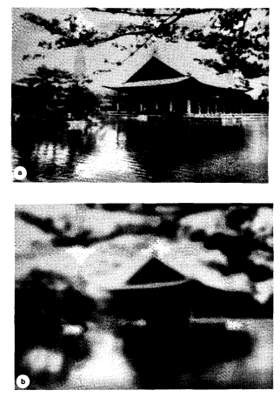
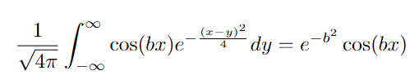
g(r) to F(Q) Convolution
A g(r) with delta peaks is strongly affected by the termination function
Gaussian peaks are less affected
Acts as a low pass filter (Weierstrass transform)
Will naturally have Gaussian dampening of frequencies in the Q domain
https://www.sciencedirect.com/science/article/pii/S0734189X87801536

Slide 11
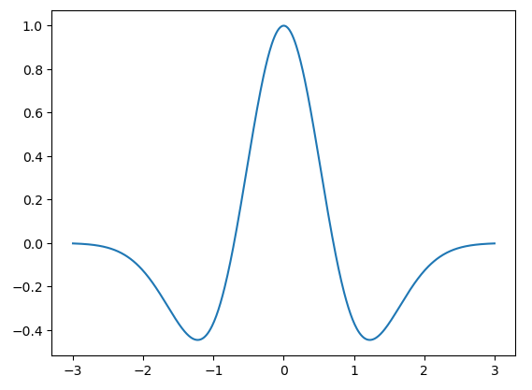
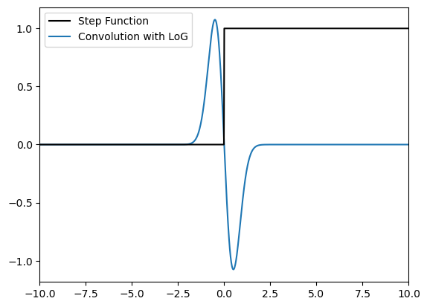
Signal Enhancing
Attempts to deblur a Gaussian led to the Laplacian of Gaussians (LoG)
When convolved with functions, has sharp intensity spikes at edges
Can be approximated by difference of two Gaussian blurs (DoG)

Slide 12
PDF Refinement

Slide 13
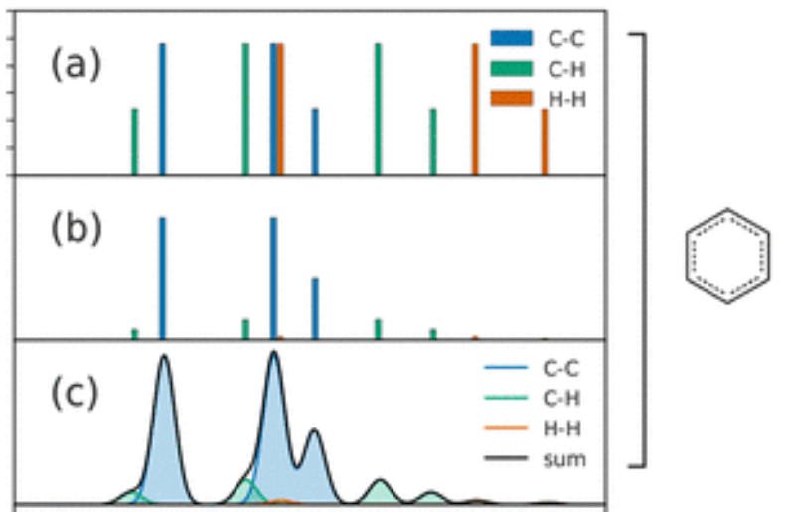
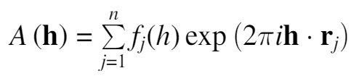
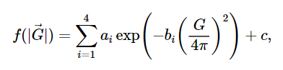
Constructing a RDF
Count number of pairs, scale by atomic form factor, and convolute each stick with the proper Gaussian
If the RDF has a Gaussian convolution, our I(Q) should have a product with a Gaussian
https://pubs.acs.org/doi/10.1021/acs.chemrev.1c00237
https://onlinelibrary.wiley.com/iucr/itc/doi/10.1107/97809553602060000935
https://lampx.tugraz.at/~hadley/ss1/crystaldiffraction/atomicformfactors/formfactors.php

Slide 14
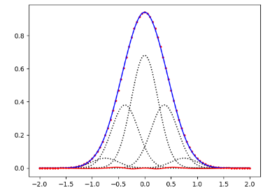
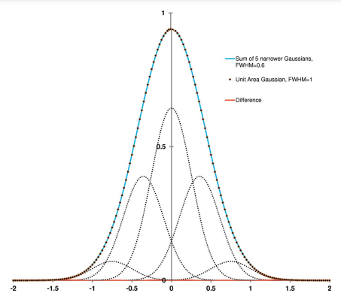
Radial Basis Function Interpolation
Sufficiently smooth functions can be approximated by a linear combination of some RBFs
https://www.sciencedirect.com/science/article/pii/S0021999109001156
Guidelines:
Choose spacing of Rmin=0.6
While the FWHM ratio between the thin and target gaussians is below Rmin, decrease Rmin and increase N (number of gaussians)
Measure maximum error percent
https://journals.iucr.org/j/issues/2015/03/00/to5109/to5109.pdf

Slide 15
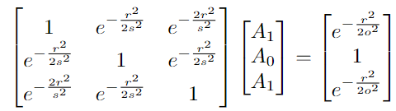
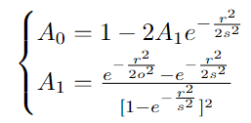
Three Gaussian Approximation
We want to approximate some Gaussian with STD ‘o’ as the sum of three Gaussians with STD ‘s’
The interpolation matrix and solution

Slide 16
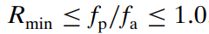
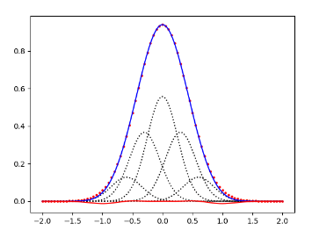
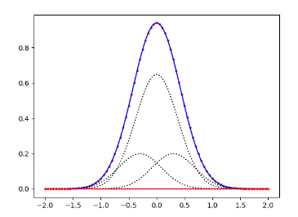
Comparing Errors
R_min is the distance between the two closest sticks to the center scaled by f_a
Strict requirements for R_min given ratio between approximating Gaussian and actual Gaussian
Worst case scenario when R_min equals the ratio
fp/fa = 0.6
Absolute Error: 0.33%
Relative Error: 0.16%
fp/fa = 0.9
Absolute Error: 0.04%
Relative Error: <0.01%

Slide 17
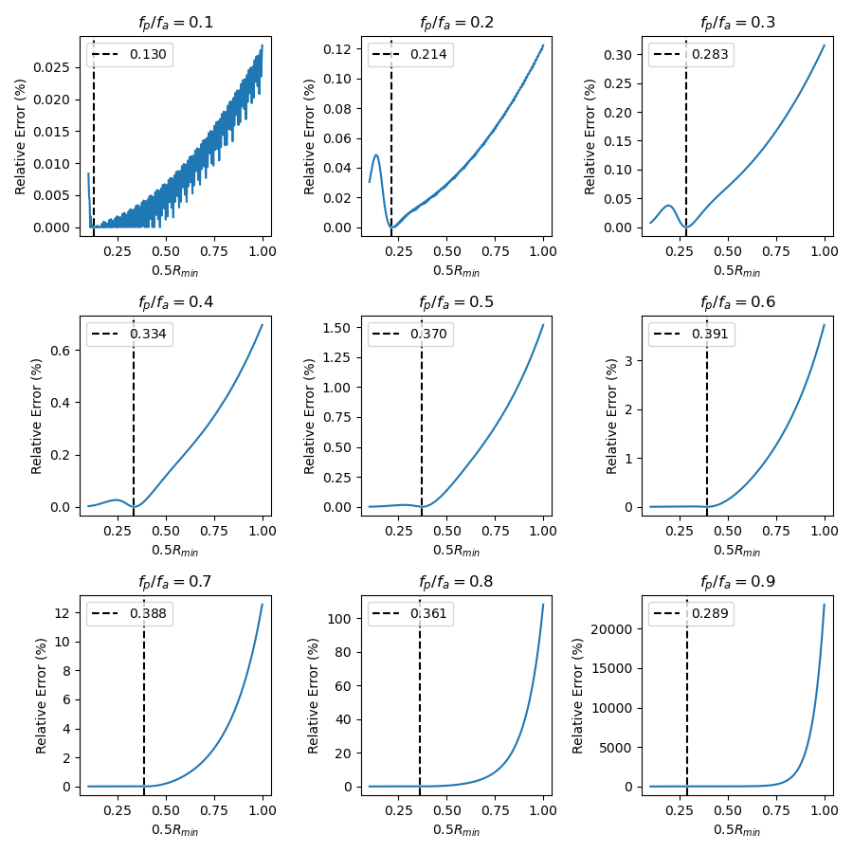
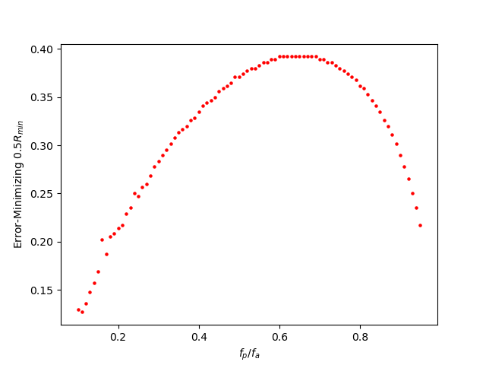
Error Minimization
The rule R_min < fp/fa generally works, and a good baseline R_min to use is 0.8
Following plots generated with fa=1

Slide 18
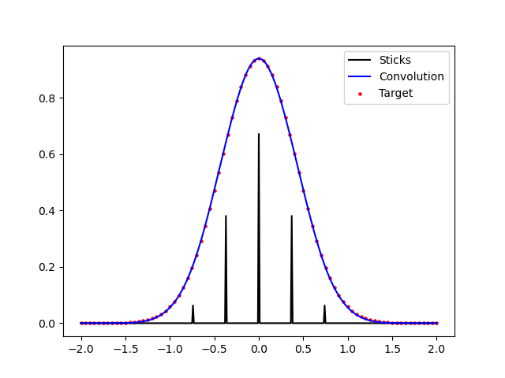
Splitting Sticks
Instead of summing Gaussians, we want to convolute a single Gaussian with a stick pattern of delta-ish patterns
We then convolve the stick pattern with a Gaussian of a single width to recreate the wider Gaussian

Slide 19
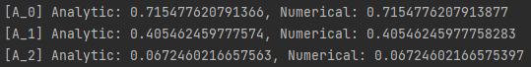
Saving Analytic Expressions
We can come up with general analytic expressions for the heights of the sticks given separation distance r, target FWHM o, and convolution FWHM s
a2 = (e**(17*r**2/s**2) - 2*e**(16*r**2/s**2) + e**(15*r**2/s**2) + e**(2*r**2*(6*o**2 + s**2)/(o**2*s**2)) + e**(2*r**2*(8*o**2 + s**2)/(o**2*s**2)) - e**(3*r**2*(11*o**2 + s**2)/(2*o**2*s**2)) - e**(r**2*(13*o**2 + 2*s**2)/(o**2*s**2)) - e**(r**2*(15*o**2 + 2*s**2)/(o**2*s**2)) - e**(r**2*(25*o**2 + 3*s**2)/(2*o**2*s**2)) + 2*e**(r**2*(29*o**2 + 3*s**2)/(2*o**2*s**2)))/(e**(r**2*(7/s**2 + 2/o**2))*(e**(10*r**2/s**2) - 3*e**(9*r**2/s**2) + e**(8*r**2/s**2) + 4*e**(7*r**2/s**2) - 2*e**(6*r**2/s**2) - 2*e**(5*r**2/s**2) - 2*e**(4*r**2/s**2) + 4*e**(3*r**2/s**2) + e**(2*r**2/s**2) - 3*e**(r**2/s**2) + 1))
We can decide on a cutoff n (such as n=5) where any ratio beyond such a cutoff is computed numerically instead

Slide 20

Questions?

